Slide 1

Programa de Impulso a la Industria de la
Ciberseguridad Nacional
#INCIBEemprende
LOGOTIPO EMPRESA COLABORADORA

Slide 2



INCIBE Emprende desarrolla iniciativas de ideación, incubación y aceleración tanto para la promoción del emprendimiento en ciberseguridad, como de la ciberseguridad en el emprendimiento de base tecnológica, con el fin de Impulsar la Industria Nacional de Ciberseguridad.
Acompañamos a emprendedores y start-ups españolas de ciberseguridad, así como de base tecnológica para la integración de la ciberseguridad en su proyecto.
Impulsamos el desarrollo de proyectos independientemente de su grado de madurez: fomento de ideas - incubación de proyectos - aceleración de start-ups e internacionalización.
Impulsamos la innovación y promocionamos la atracción de inversión a la misma.
Plan de Recuperación, Transformación y Resiliencia (PRTR) a través del Componente 15. Inversión 7 Ciberseguridad: Fortalecimiento de las capacidades de ciudadanos, PYMES y profesionales e impulso del sector.
LOGOTIPO EMPRESA COLABORADORA

Slide 3




Start-ups vs emprendimiento
tradicional
Empresas digitales/base tecnológica
Explotación de nuevos modelos de negocio
Modelo de negocio escalable: crecimiento exponencial en ventas y crecimiento lineal en costes
Ventaja competitiva basada en la innovación
Alto riesgo debido a su alto contenido innovador
Necesidad de elevado volumen de financiación y dificultad de acceso a la misma en fases iniciales
Fuentes de financiación FFF (family, fools and Friends), capital riesgo, business angels. La garantía la supone el equipo.
Dependencia en captación y retención de empleados altamente cualificados.
Explotación de modelos de negocio convencionales
Crecimiento estable, modelo de negocio sostenible
Fuente de financiación tradicional: préstamos y recursos propios. Garantía real y/o personal.
Centrada en mantener el negocio y/o generar un crecimiento % estable.
LOGOTIPO EMPRESA COLABORADORA

Slide 4





Sector de la ciberseguridad
122.284
24.119
83.000
Participación mundial en la industria de ciberseguridad
SECTOR
EN AUGE
Trabajadores empleados
(2021)
Brecha de talento
(2021)
Brecha de talento
(2024)
31%
69%
Participación estudiantes grados STEM
VALOR ECOSISTEMA*
24%
76%
1.500M
8,12%
2.000M
Participación estudiantes cursos ciberseguridad
Año 2020
Crecimiento anual
Previsión 2024
18%
82%
*Fuente: Security Spending Guide IDC 2021
LOGOTIPO EMPRESA COLABORADORA

Slide 5


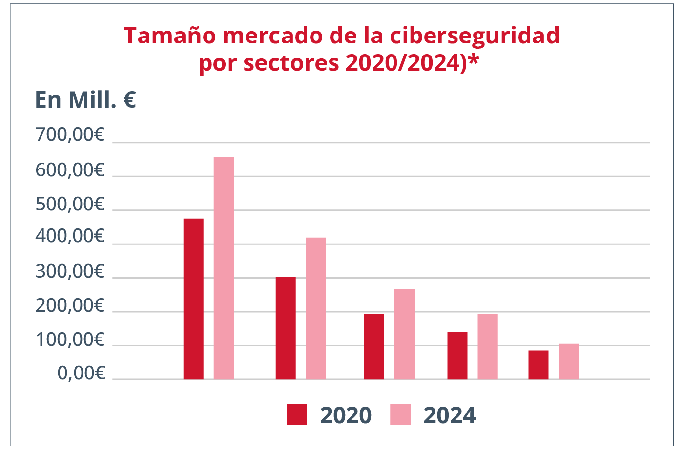


Sector de la ciberseguridad
Ciberseguridad
Digitalización sectores
La importancia de la
ciberseguridad es
transversal a
todos los sectores
de la economía
La digitalización de
todos los sectores está
favorenciendo un
crecimiento global
del mercado de la
Ciberseguridad
El sector que más peso aporta a la ciberseguridad
es el de distribución y servicios, seguido del financiero
*Fuente: Security Spending Guide IDC 2021
LOGOTIPO EMPRESA COLABORADORA

Slide 6


Programa de apoyo al
Emprendimiento en
ciberseguridad
Captación / Ideación
Incubación
Aceleración
Formación
Mentorización
Asesoramiento legal
Asesor fiscal
Visita al ecosistema regional
Demo Day
Aceleración Express
Charlas
Talleres
Eventos
Formación
Mentorización
Asesoramiento legal
Asesor fiscal
Visita al ecosistema regional
Demo Day
LOGOTIPO EMPRESA COLABORADORA

Slide 7

Captación / Ideación
Título de la charla
Presentación de la entidad
Descripción de la charla
Las siguientes diapositivas serán las correspondientes al contenido de la charla correspondiente. En caso de querer añadir diapositivas, añadir una o duplicar la anterior.
Botón derecho > cambiar gráfico > escoger el logo de la entidad correspondiente
LOGOTIPO EMPRESA COLABORADORA

Slide 8


Desde las Profundidades del Kernel: Cómo Crear un Rootkit Invisible en WINDOWS
Descifrando el desarrollo de un Rootkit para Windows 11
INCIBE Emprende, 2025 [in/vazquez-vazquez-alejandro]

Slide 9
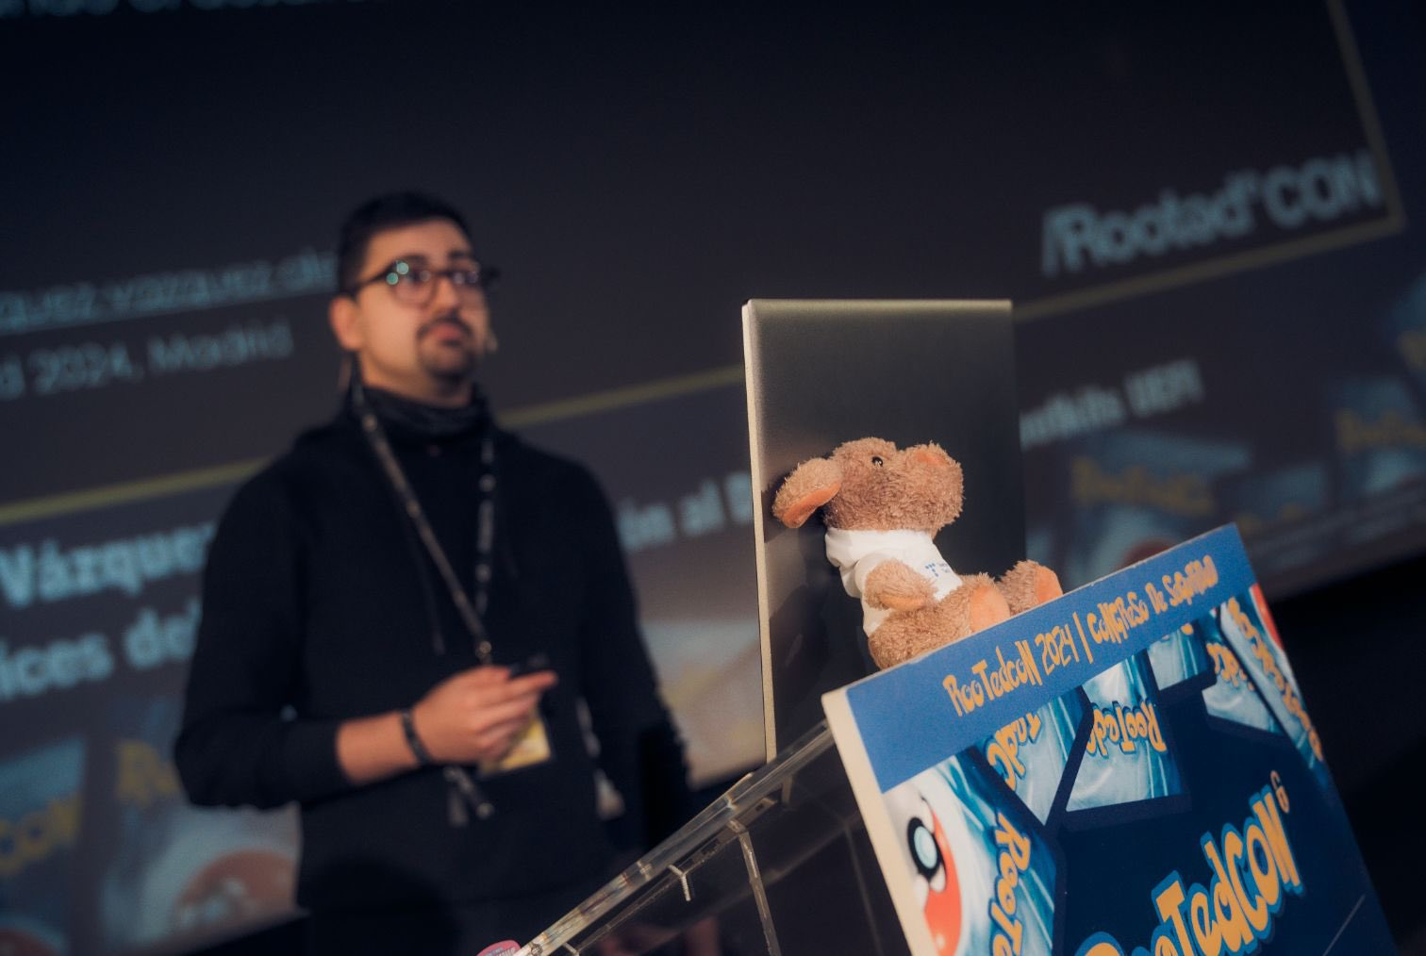

Whoami
FRIKI (Fanático de Revolucionar Internamente Kernels e Inicios del sistema)
Pastor de ovejas desde los 8 años
Me gusta el pulpo, de ahí los Rootkits
Docente en Máster de Análisis de Malware

Slide 10
Table of Contents
Rootkit Development
Concepts
Kernel
Rootkit
Security Mechanisms
Checkpoint
Development Environment
Script
Kernel Mode Driver
Our Malicious Driver
Development
Communication, Keylogger
Hide Processes, Hide Folders
Network Control, Network Requests
Infection
B/Rootkits in the Wild
FudModule
Fire Chili
SPEcter

Slide 11
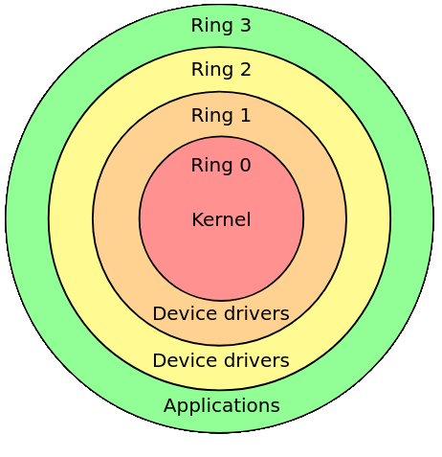
Kernel (Ring 0)
The kernel (Ring 0) of an operating system implements the core functionality that everything else in the operating system depends upon. The Microsoft Windows kernel provides basic low-level operations such as scheduling threads or routing hardware interrupts. It is the heart of the operating system and all tasks it performs must be fast and simple.
~ Microsoft

Slide 12
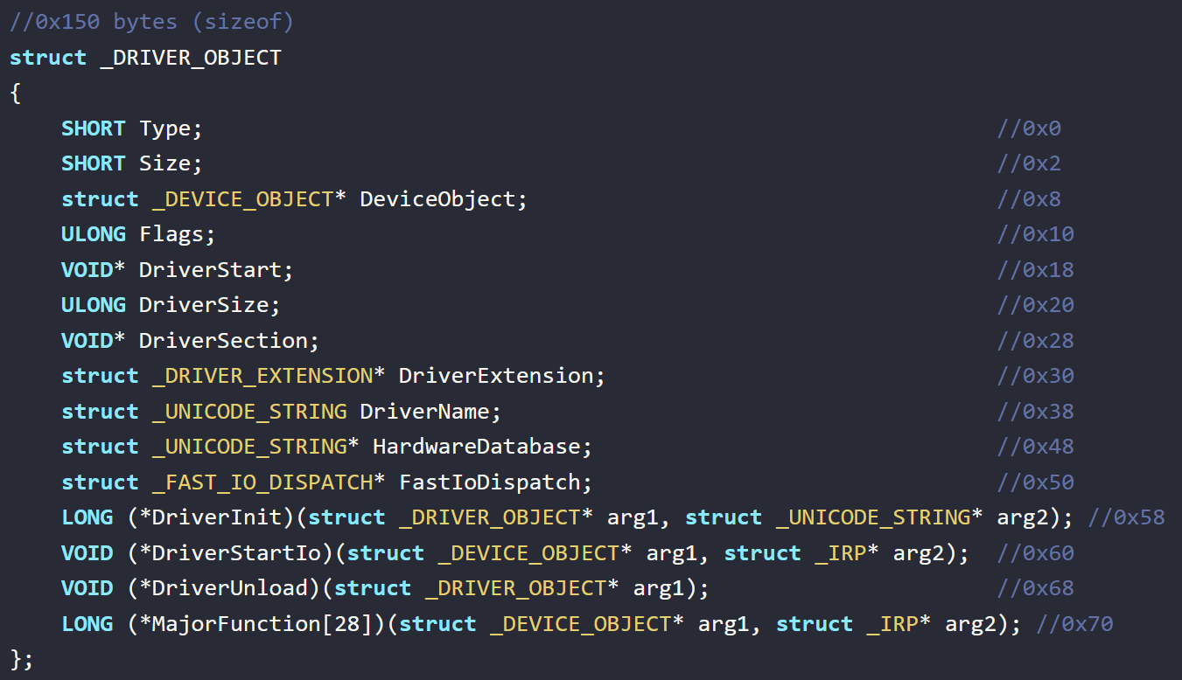
Kernel (Ring 0)
The kernel (Ring 0) of an operating system implements the core functionality that everything else in the operating system depends upon. The Microsoft Windows kernel provides basic low-level operations such as scheduling threads or routing hardware interrupts. It is the heart of the operating system and all tasks it performs must be fast and simple.
~ Microsoft

Slide 13
Rootkit
Rootkit: Sophisticated piece of malware that can add new code to the operating system or delete and edit operating system code. Rootkits may remain in place for years because they are hard to detect, due in part to their ability to block some antivirus software and malware scanner software.
~ Crowdstrike

Slide 14

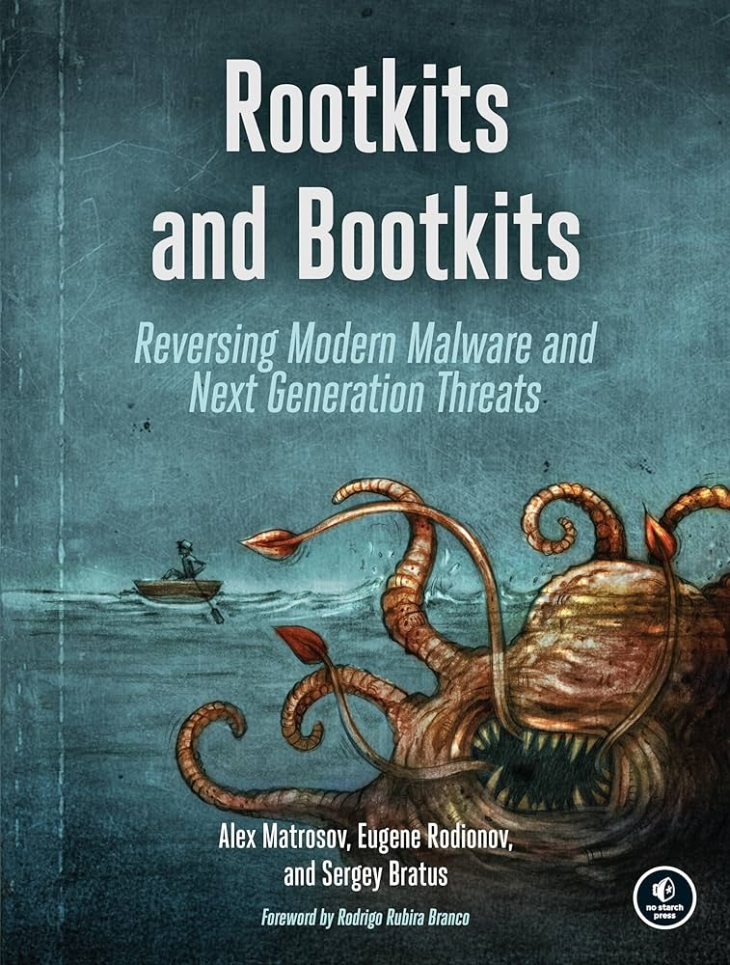
Rootkit
Rootkit: Sophisticated piece of malware that can add new code to the operating system or delete and edit operating system code. Rootkits may remain in place for years because they are hard to detect, due in part to their ability to block some antivirus software and malware scanner software.
~ Crowdstrike
Kernel-Mode Driver
C/C++ - driver.sys

Slide 15
Security Mechanisms
[Anti-Rootkit Installation]
Driver Signature Enforcement (DSE)
Windows won't run drivers not certified by Microsoft
[Anti-Rootkit Deep Funcionalities]
Kernel Patch Protection (PatchGuard)
Feature of 64-bit editions of Microsoft Windows
Prevents patching the kernel

Slide 16
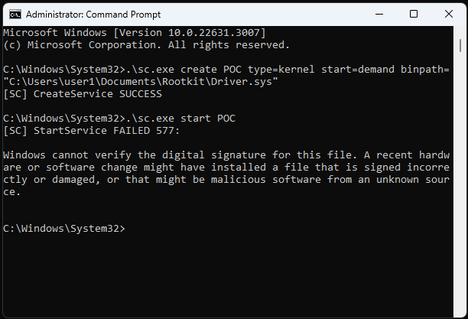
Security Mechanisms
[Anti-Rootkit Installation]
Driver Signature Enforcement (DSE)
Windows won't run drivers not certified by Microsoft
[Anti-Rootkit Deep Funcionalities]
Kernel Patch Protection (PatchGuard)
Feature of 64-bit editions of Microsoft Windows
Prevents patching the kernel
1
2

Slide 17
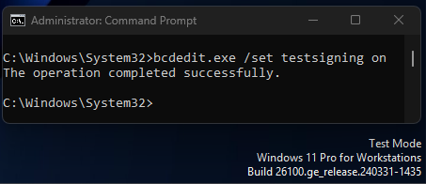
Security Mechanisms
[Anti-Rootkit Installation]
Driver Signature Enforcement (DSE)
Windows won't run drivers not certified by Microsoft
[Anti-Rootkit Deep Funcionalities]
Kernel Patch Protection (PatchGuard)
Feature of 64-bit editions of Microsoft Windows
Prevents patching the kernel
1
2

Slide 18
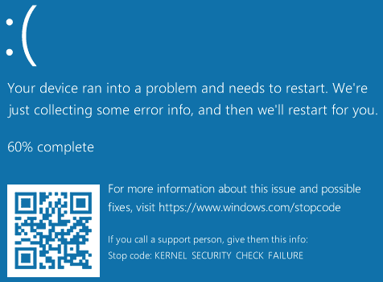
Security Mechanisms
[Anti-Rootkit Installation]
Driver Signature Enforcement (DSE)
Windows won't run drivers not certified by Microsoft
[Anti-Rootkit Deep Funcionalities]
Kernel Patch Protection (PatchGuard)
Feature of 64-bit editions of Microsoft Windows
Prevents patching the kernel
1
2

Slide 19

Checkpoint
Rootkit Development
Windows Kernel
Rootkit = Kernel Mode Driver
DSE, PatchGuard, …

Slide 20
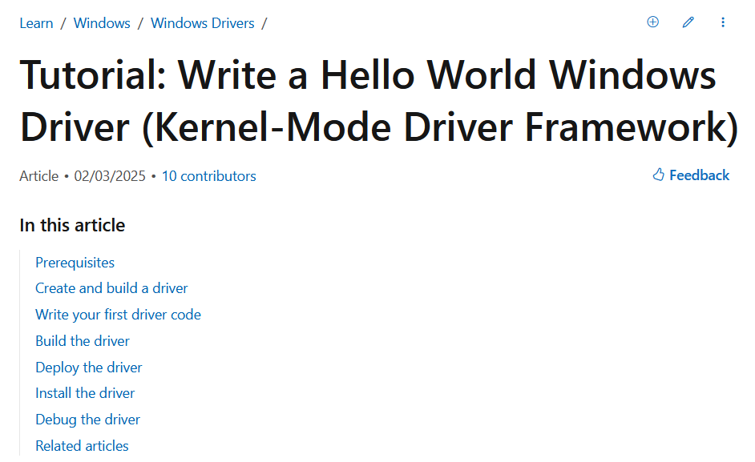
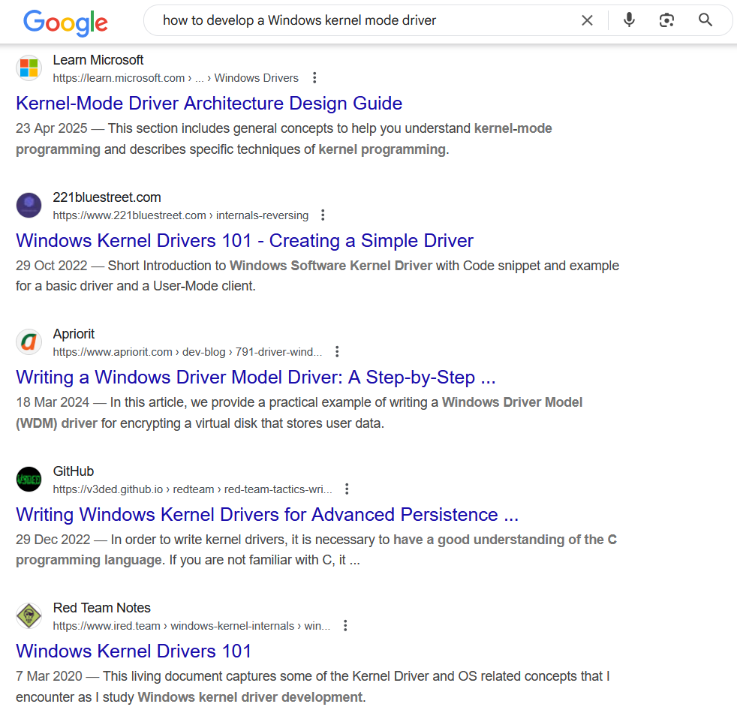










Development Environment

Slide 21
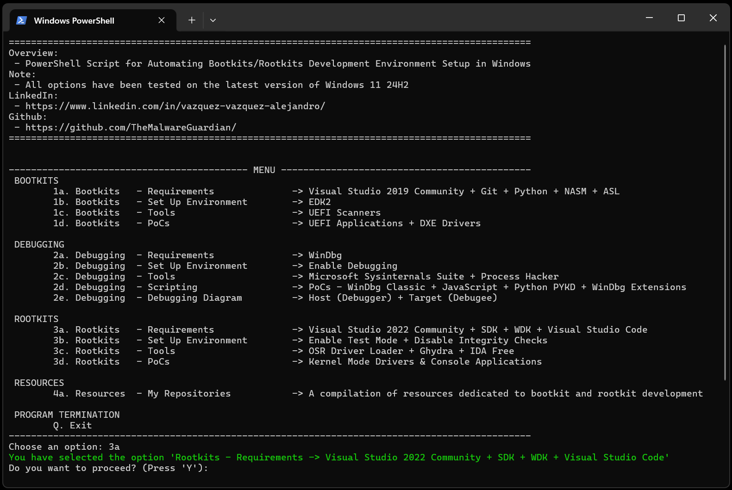
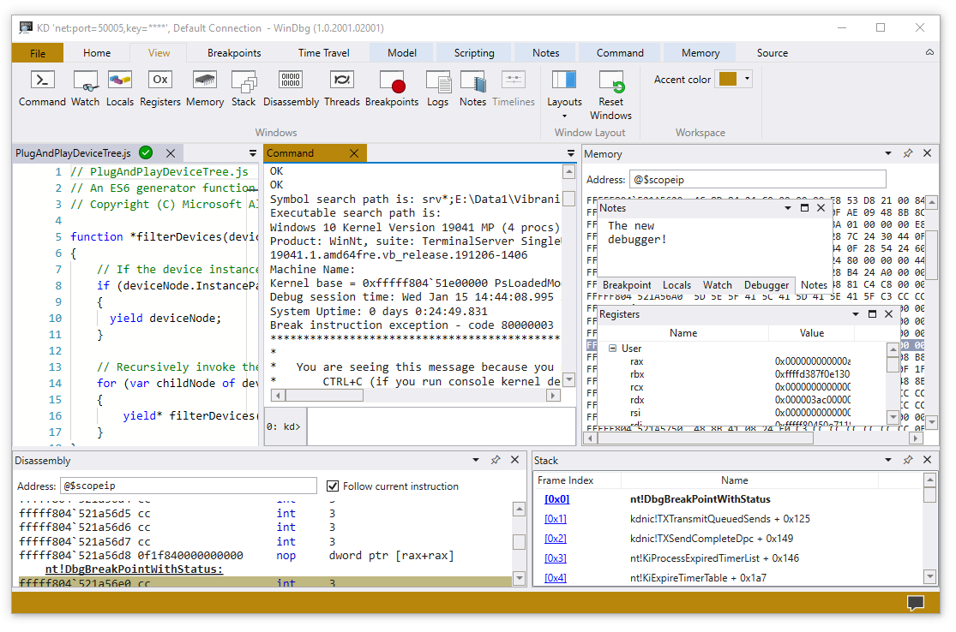


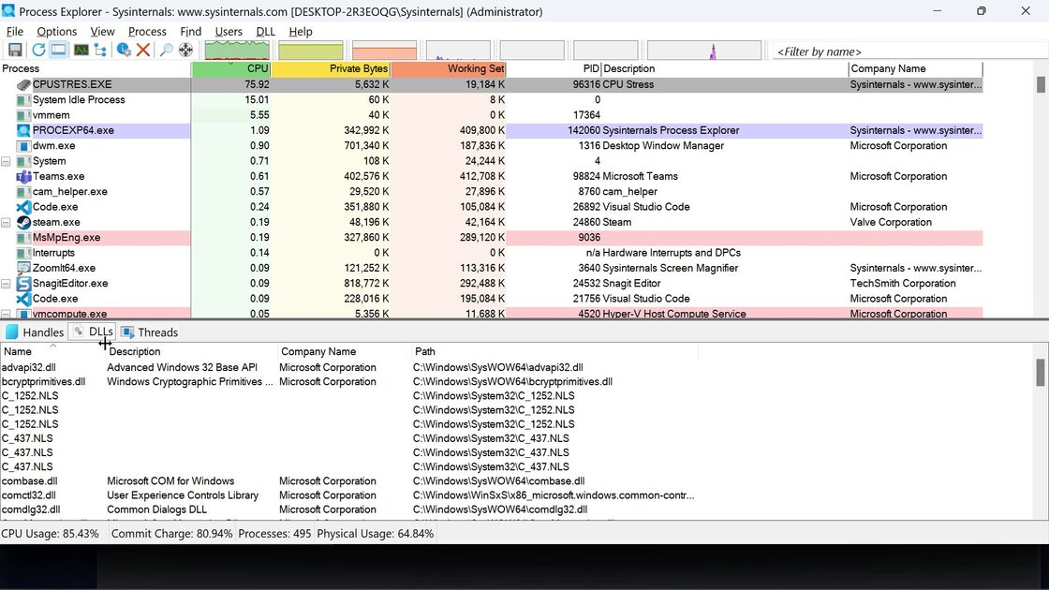

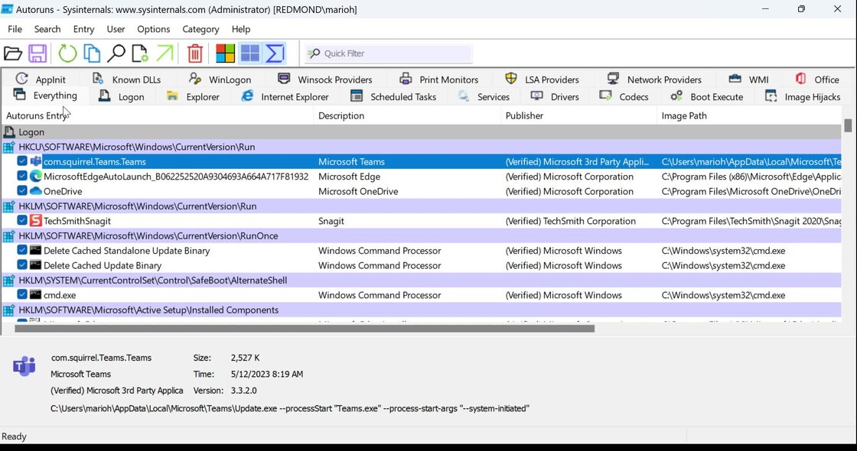
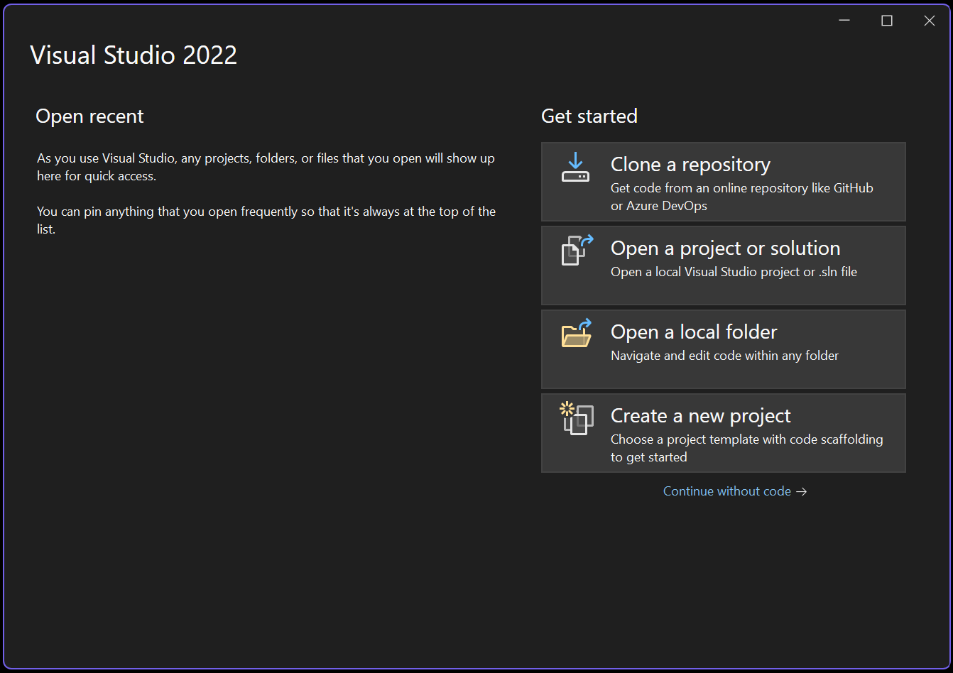
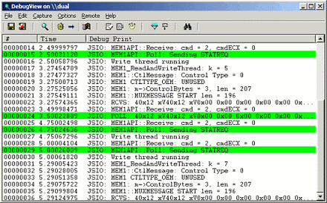
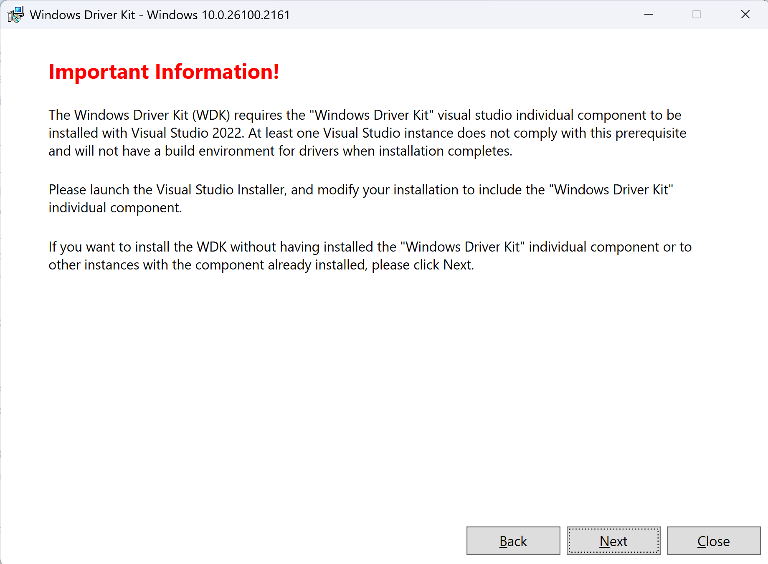



Development Environment

Slide 22
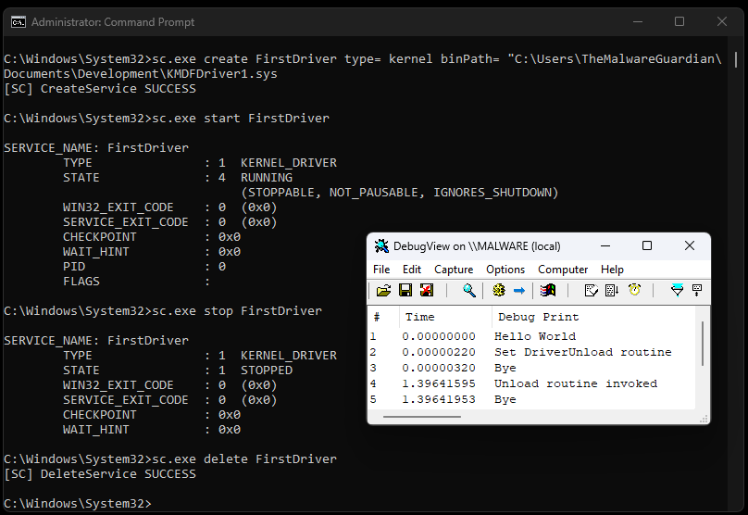
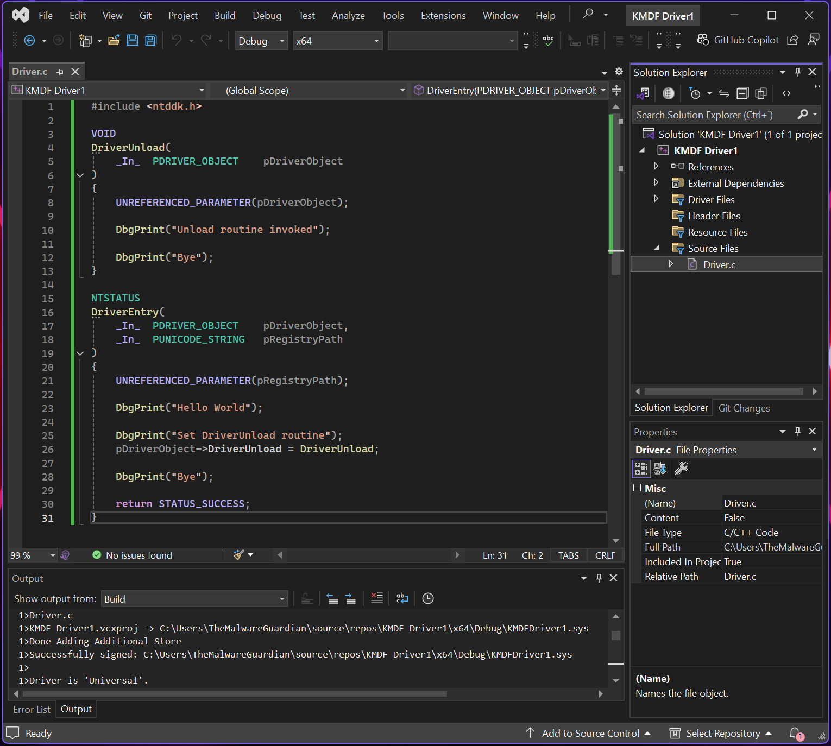
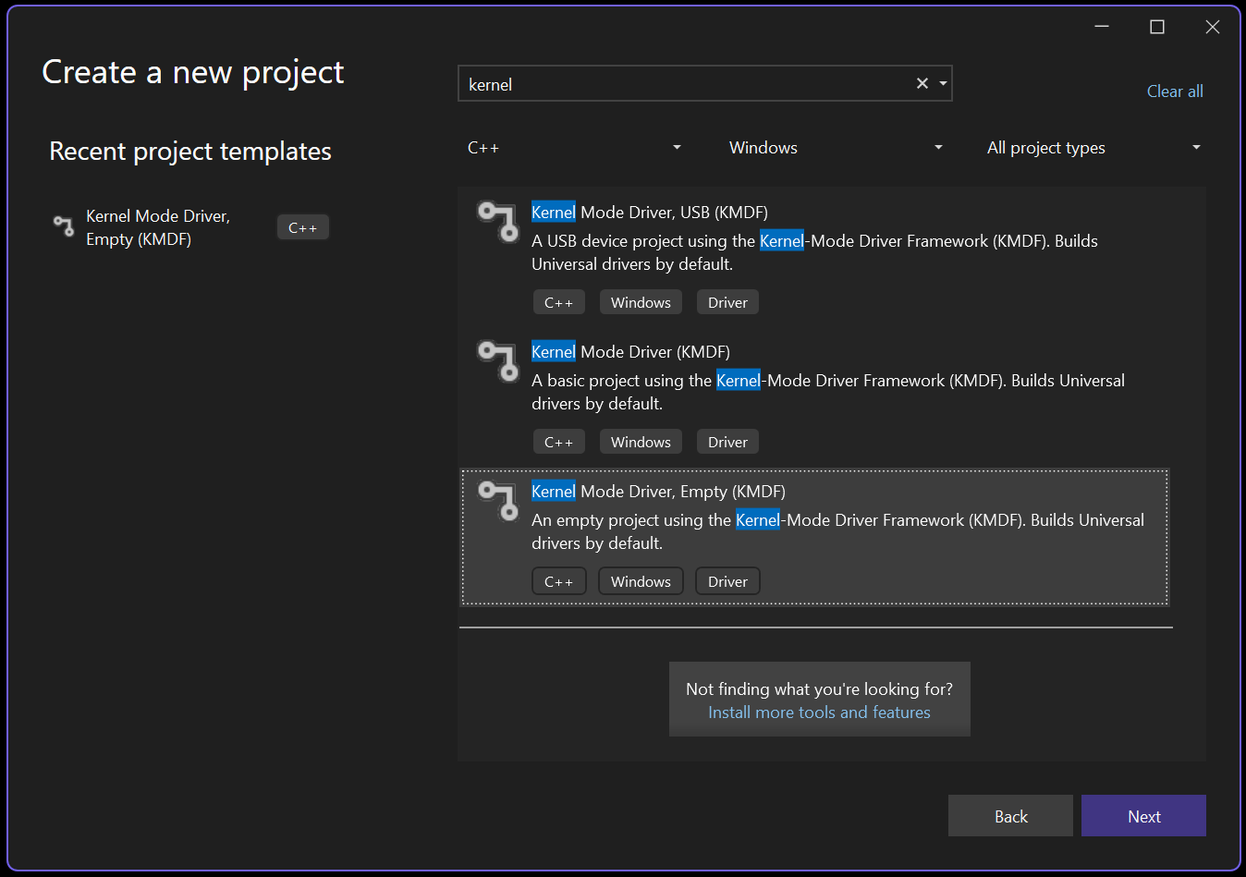
Kernel Mode Driver

Slide 23
Malicious Driver
User Mode - Kernel Mode Communication Toolkit
Direct Kernel Object Modification Hide Processes
Keyboard and Mouse Filter Keylogger
Windows Filtering Platform Network Control
Windows Kernel Sockets Network Requests
File System Minifilter Driver Hide Folders
ntddk.h
Communication
ntddk.h
DKOM
ntddk.h
Keyboard Filter
fwpmk.h, fwpsk.h, fwpmu.h
WFP
wsk.h
WSK
fltKernel.h
Minifilter

Slide 24


Bentico
KernelRootkit001_HelloWorld
KernelRootkit002_Threading
KernelRootkit003_ZwFunctions
KernelRootkit004_Callbacks
KernelRootkit005_IOCTLs
KernelRootkit006_DKOM
KernelRootkit007_KeyboardFilter
KernelRootkit008_Minifilter
KernelRootkit009_FilterCommunicationPort
KernelRootkit010_WindowsFilteringPlatform
KernelRootkit011_WinSockKernel

Slide 25



Communication
“The bridge between user mode and kernel mode: IOCTL requests initiate communication, while IRPs manage data exchange and driver actions.”
Via Input/Output Control Codes and Input/Output Request Packets
Via Filter Communication Ports
Via Network Requests
Via Shared Memory
Via Registry Keys
Via Files
Via …
I

Slide 26
Communication
User Mode
Kernel Mode
console_application.exe
kernel_mode_driver.sys
// -----------------------
#define IOCTL_COMM_0 CTL_CODE(FILE_DEVICE_UNKNOWN, 0x800, METHOD_BUFFERED, FILE_ANY_ACCESS)
// -----------------------
hDevice = CreateFile(L"\\\\.\\MyKernelDriver", GENERIC_READ | GENERIC_WRITE, ...
// -----------------------
BOOL success = DeviceIoControl(hDevice,
1 IOCTL_COMM_0,
2 inBuffer, sizeof(inBuffer),
3 outBuffer, sizeof(outBuffer),
&bytesReturned, NULL);
// -----------------------
#define IOCTL_COMM_0 CTL_CODE(FILE_DEVICE_UNKNOWN, 0x800, METHOD_BUFFERED, FILE_ANY_ACCESS)
// -----------------------
status = IoCreateDevice(...);
status = IoCreateSymbolicLink(...);
// -----------------------
pDriverObject->MajorFunction[...] = ...;
pDriverObject->MajorFunction[IRP_MJ_DEVICE_CONTROL] = DriverHandleIOCTLs;
// -----------------------
NTSTATUS
DriverHandleIOCTLs(
_In_ PDEVICE_OBJECT pDeviceObject,
_In_ PIRP pIrp
)
{
PIO_STACK_LOCATION stack = IoGetCurrentIrpStackLocation(pIrp);
ULONG controlCode = stack->Parameters.DeviceIoControl.IoControlCode;
switch (controlCode)
{
case IOCTL_COMM_0:
...
break;
case IOCTL_COMM_1:
...
break;
pIrp->IoStatus.Status = STATUS_SUCCESS;
IoCompleteRequest(pIrp, IO_NO_INCREMENT);
return STATUS_SUCCESS;
}
IRP
typedef struct _IRP {}
Handle IRP
IRP_MJ_DEVICE_CONTROL
Simbolic Link
"\\DosDevices\\MyKernelDriver"
Device Object
"\\Device\\MyKernelDriver"

Slide 27
Hide Procesess
“Windows maintains a doubly linked list of active processes in (LIST_ENTRY) EPROCESS->ActiveProcessLinks. Unlink a process from the chain, and it disappears from user-mode enumeration.”
struct EPROCESS
{
…
LIST_ENTRY 0x1d8
{
FLINK
BLINK
}
…
}
struct EPROCESS
{
…
LIST_ENTRY 0x1d8
{
FLINK
BLINK
}
…
}
struct EPROCESS
{
…
LIST_ENTRY 0x1d8
{
FLINK
BLINK
}
…
}
struct EPROCESS
{
…
LIST_ENTRY 0x1d8
{
FLINK
BLINK
}
…
}
struct EPROCESS
{
…
LIST_ENTRY 0x1d8
{
FLINK
BLINK
}
…
}
II

Slide 28
Keylogger
“Keystroke interception in kernel mode: The Windows keyboard driver stack routes all keystrokes through a device object called \Device\KeyboardClass0. By attaching a driver to this device and registering a CompletionRoutine (a callback executed after an IRP has been processed by lower drivers, allowing access to data before it reaches the next stage), we can capture raw keystroke data before it propagates to user-mode applications like text editors or browsers.”
Keyboard Class Driver
(kbdclass.sys)
\Device\KeyboardClass0
Keyboard Port Driver
(i8042prt.sys)
Keyboard Filter Drivers
(Optional 1..N)
Keylogger Driver
\Device\My Keylogger
III
Attached to intercept IRP_MJ_READ requests and set a CompletionRoutine to capture keystroke data.
User Mode
Physical Keyboard

Slide 29
Network Control
“Windows Filtering Platform (WFP) allows real-time inspection and control of network connections. By attaching filters (static rules applied at specific layers of the network stack to identify traffic based on attributes like IPs or ports) and callouts (custom drivers that execute dynamic logic on flagged traffic), it’s possible to classify traffic based on metadata such as the remote IP address and the associated process. Traffic that matches specific rules can be blocked, logged, or modified, enabling comprehensive network security policies.”
Conditions
Layer 1
Filter A
Network Stack
Fields
Callout F
Conditions
Filter Engine
Filter B
Callout G
Layer 2
Conditions
IV
Fields
Filter C
Conditions
Callout H
Layer 3
Filter D
Fields
Conditions
Filter E

Slide 30
Network Requests
“WinSock Kernel (WSK) allows kernel-mode programs to perform complex network operations, such as establishing connections, binding sockets, and transferring data. With support for asynchronous communication using IRPs, WSK enables efficient and controlled interaction with network protocols, ensuring low-latency communication and making it a robust solution for implementing kernel-level networking features.”
I/O Manager
WinSock Kernel (WSK)
V
TCP/IPV4
\Device\TCP
\Device\UDP
\Device\RAW
TCP/IPV6
\Device\TCP6
\Device\UDP6
\Device\RAW6
3 Party
\Device\Proto

Slide 31
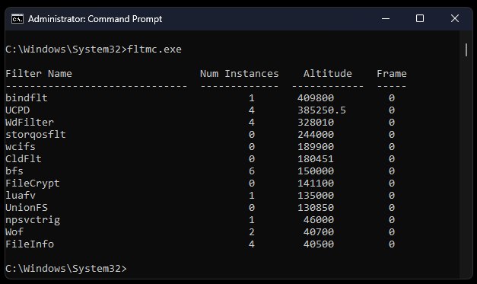

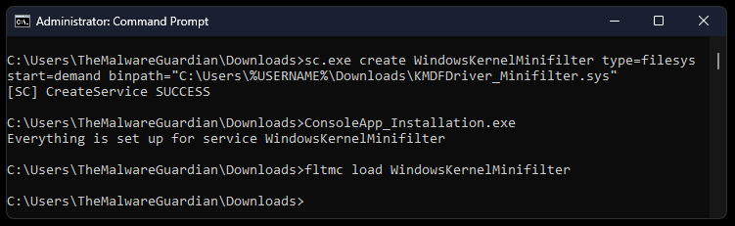
Hide Folders
“MiniFilters attach to the file system stack to filter I/O operations. Using a PreOperation callback (triggered before the file system processes a request), access to files or directories can be explicitly denied by returning STATUS_ACCESS_DENIED or FLT_PREOP_COMPLETE. In the PostOperation callback (triggered after the request finishes), the DirectoryBuffer - which temporarily holds the directory listing - can be modified to remove specific entries, effectively making files and folders invisible to user-mode applications like File Explorer.”
VI

Slide 32


The Gateway
Rootkit Installation
Kernel Mode Driver

Slide 33
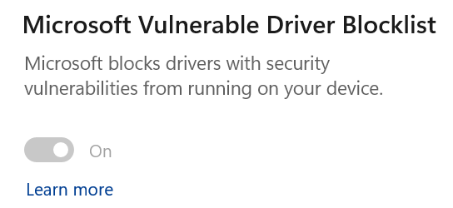
The Gateway
Rootkit Installation
Kernel Mode Driver
1. Vulnerable Kernel Driver (BYOVD)
Not Well Known
Bring Your Own Vulnerable Driver

Slide 34
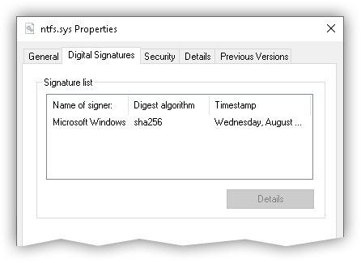

The Gateway
Rootkit Installation
Kernel Mode Driver
1. Vulnerable Kernel Driver (BYOVD)
2. Leaked Certificate Driver Signing Policy
Not Well Known
Bring Your Own Vulnerable Driver

Slide 35


The Gateway
Rootkit Installation
Kernel Mode Driver
1. Vulnerable Kernel Driver (BYOVD)
2. Leaked Certificate Driver Signing Policy
3. UEFI Bootkit Infect a Computer’s Boot process
Not Well Known
Bring Your Own Vulnerable Driver
SecureBoot
Physical Access

Slide 36



B/Rootkits In The Wild
2022
2024
MoonBounce
CosmicStrand
Fire Chili
Bootkitty
Fudmodule
1
2
2023
2021
ESPecter
FinSpy
Moriya
BlackLotus
3

Slide 37
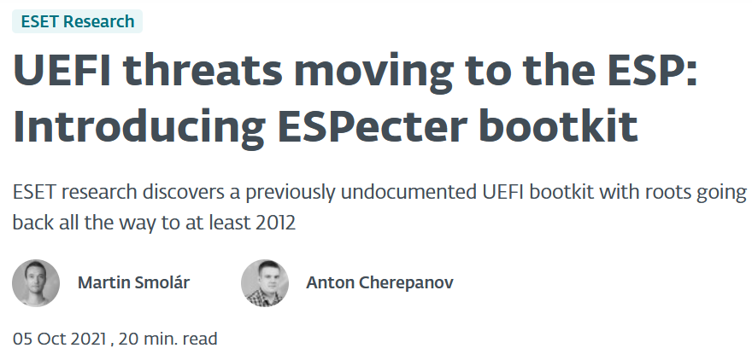
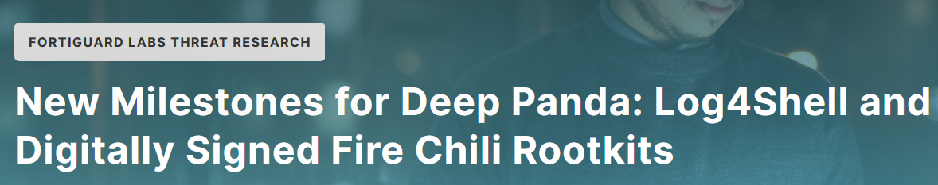
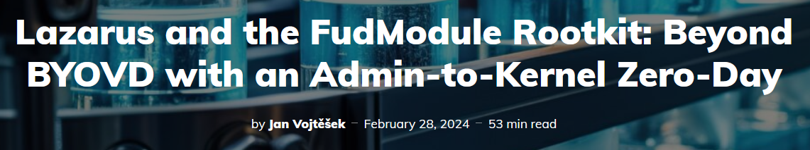
Fudmodule, Fire Chili, ESPecter

Slide 38

Demo

Slide 39




Reverse Engineering /
Malware Analysis /
Bug Hunting
Module 10 – Windows Reverse Engineering
• Windows architecture (User mode and Kernel mode) • Windows protections (DSE, KPP, VBS, CFG) • Malware hunting with SysInternals tools • Windows kernel opaque structures (EPROCESS, ETHREAD) • Windows kernel debugging • WinDbg scripting (Commands, Javascript, PyKd) • Rootkit hooking techniques (IDT, SSDT) • Rootkit development (Kernel Mode Drivers) • Bootkit development (UEFI Applications) • Bootkit analysis (ESPecter, BlackLotus) • Kernel exploitation (Vulnerable drivers, Write-What-Where)

Slide 40
Thank You ☺
Every resource you need to develop Rootkits:
github.com/TheMalwareGuardian/Awesome-Bootkits-Rootkits-Development
Automate Bootkits/Rootkits Development
github.com/TheMalwareGuardian/Bootkits-Rootkits-Development-Environment
Contact:
www.linkedin.com/in/vazquez-vazquez-alejandro

Slide 41
¡Ahora te toca!
¿Tienes una idea de negocio en ciberseguridad, tu proyecto necesita de ciberseguridad?
¡Te ayudamos a emprender!
¡Apúntate a los próximos talleres de emprendimiento!
¡O solicita plaza en el programa de Incubación de INCIBE Emprende!
LOGOTIPO EMPRESA COLABORADORA

Slide 42
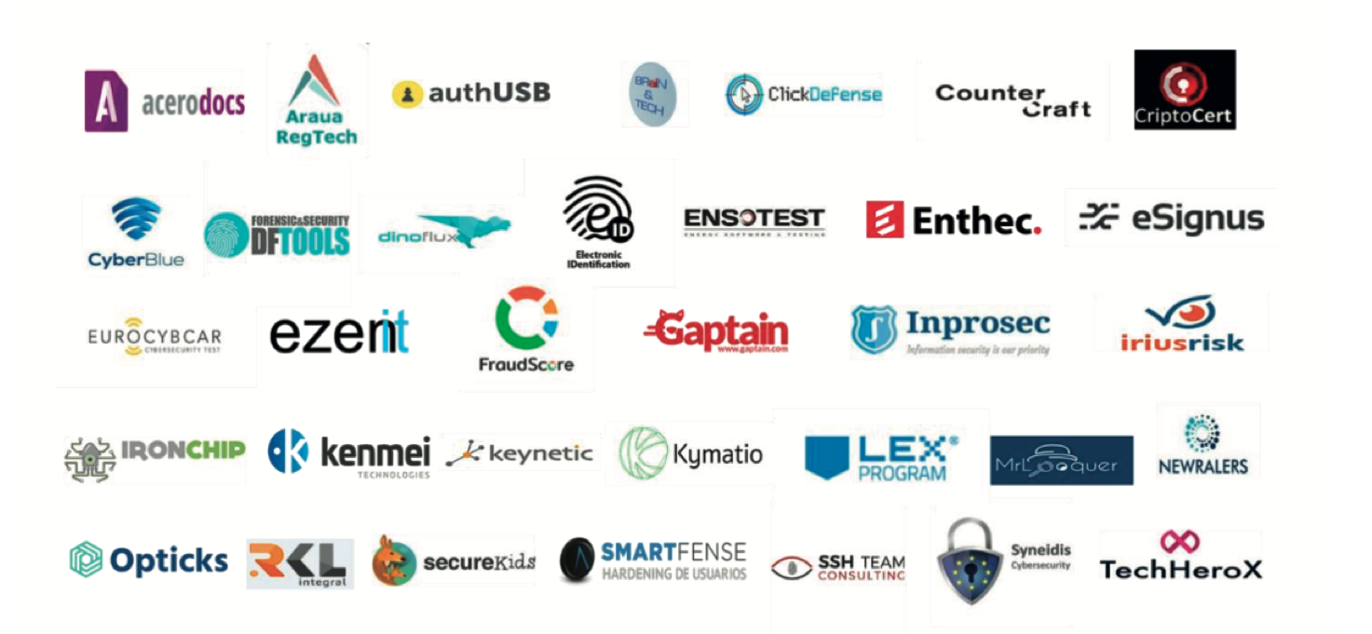
Ediciones anteriores
LOGOTIPO EMPRESA COLABORADORA

Slide 43


INCIBE Emprende
¡Te estamos esperando!
Indicar correo electrónico aquí
Indicar teléfono de contacto aquí
Indicar web aquí

Slide 44

Programa de Impulso a la Industria de la
Ciberseguridad Nacional
#INCIBEemprende
LOGOTIPO EMPRESA COLABORADORA

